Slide 1
Autistica Challenge
Team 21
Lalitha Priya Bhupalam | Mehdi Naderi Varandi | Yavor Edipov | James Craster | Oluwafemi Oladipo | Iurii Maksymets

Slide 2
Aim
Automate
Automate the resources and steps needed for a longitudinal study
Create
Create great user experience
Provide
Provide critical insights to researchers and employers

Slide 3
Difficult to Reach more people
Misdiagnoses can occur due to lack of understanding/studies done solely on men
Challenges for the Client

Slide 4
Live Tech Demo

Slide 5
Easily accessible by anyone, on any device
Simple and easy to use
Extremely customizable – suits any users needs
Provides immediate insight
Allows researcher/employer to customise and add new questions
Benefits and advantages of our solution

Slide 6
Roadmap
In the future, we can:
Leverage NLP to provide insights about qualitative data
Most of the work on this is done already!

Slide 7
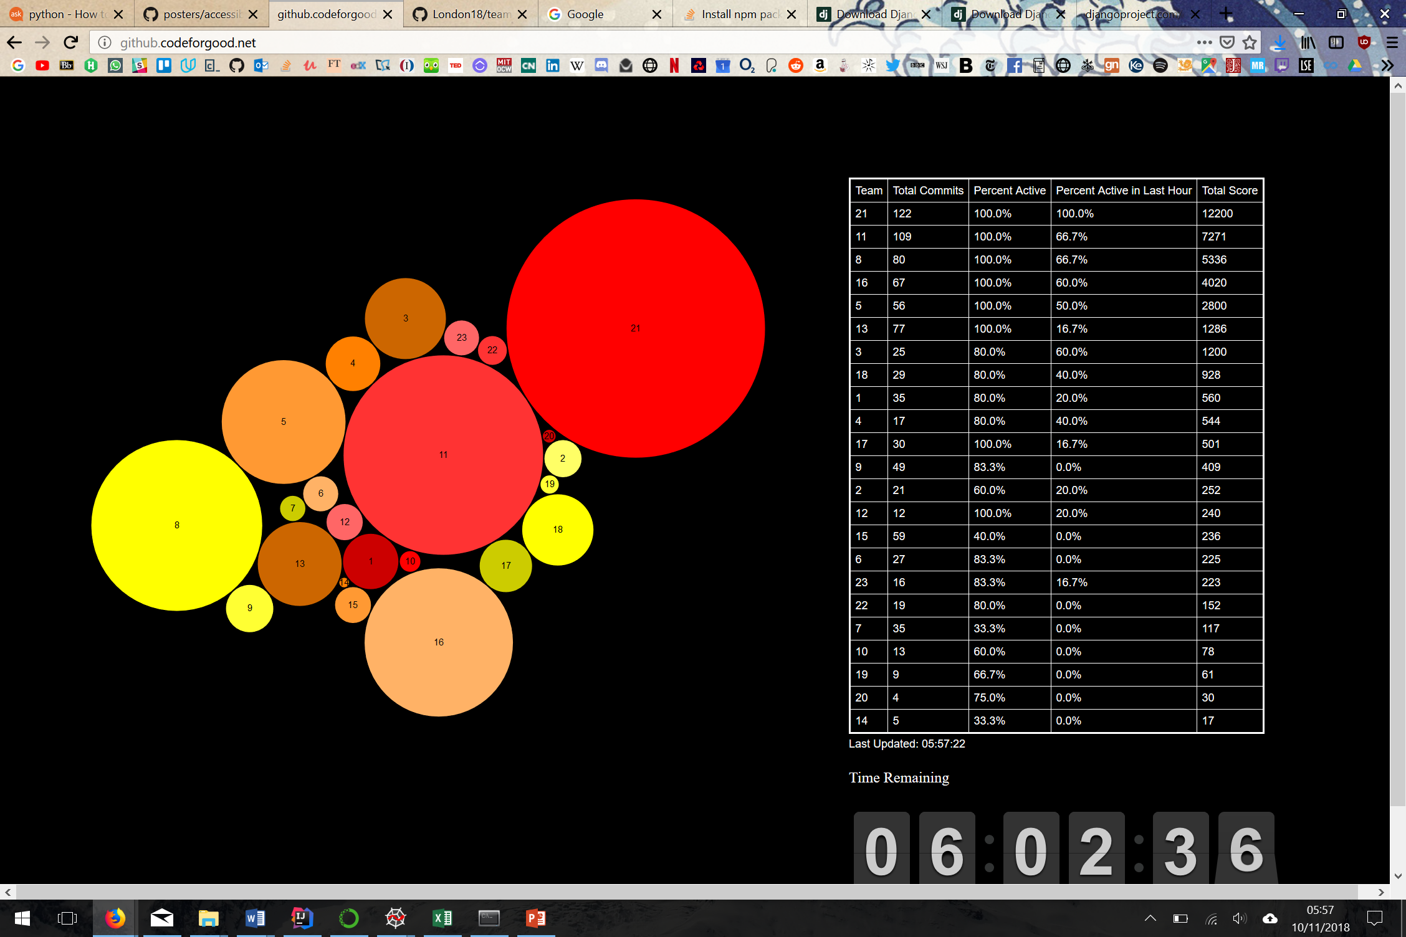
Our Accreditations and awards
21
21

